Slide 1

STELLA OBASANJO HOSPITAL Edo state ministry of Health
SOH RECALIBRATION COST
TANIT MEDICAL ENGINEERING
TANIT MEDICAL ENGINEERING January 2023

Slide 2
Summary
The entire project (OPD, IPD, Administrative block & Mortuary) of the SOH for ease of execution Option 3 has been Selected.
Option 3
Included
OPD
IPD
Diagnostics
Dialysis
IVF
ER
36 Surgical
Medical gases
Excluded
ADMINISTRATIVE BLOCK
Portions of IPD
MORTUARY
TANIT MEDICAL ENGINEERING
TANIT MEDICAL ENGINEERING January 2023

Slide 3
Financials
FULL PROJECT
(WITH ADMINISTRATIVE BLOCK)
₦18,509,626,266.76
OPTIONS | SCENARIO TOTAL SUM (₦) | DIFFERENCE (₦) | SCENARIO COVERAGE AREAS
OPTION 1 | 14,909,802,833.20 | 3,599,823,433.56 | OPD,IPD,MORTUARY , BUT EXCLUDING ADMINISTRATIVE BLOCK
OPTION 2 | 10,000,734,122.80 | 8,508,892,143.96 | OPD,IPD(DIAGNOSTIC,DIALYSIS,IVF, ER AND MEDICAL GASES),MORTUARY , BUT EXCLUDING ADMINISTRATIVE BLOCK AND ALL OTHER PORTIONS OF IPD
OPTION 3 | 8,754,842,710.28 | 9,754,783,556.48 | OPD,IPD(DIAGNOSTIC, ER, 36 SURGICALS AND MEDICAL GASES) BUT EXCLUDING ADMINISTRATIVE BLOCK , ALL OTHER PORTIONS OF IPD, AND MORTUARY
OPTION 4 | 8,564,321,711.46 | 9,945,304,555.30 | OPD,IPD(DIAGNOSTIC,DIALYSIS,IVF, AND ER),MORTUARY , BUT EXCLUDING ADMINISTRATIVE BLOCK , ALL OTHER PORTIONS OF IPD, MORTUARY, AND MEDICAL GASES
Phase
TANIT MEDICAL ENGINEERING
TANIT MEDICAL ENGINEERING January 2023

Slide 4
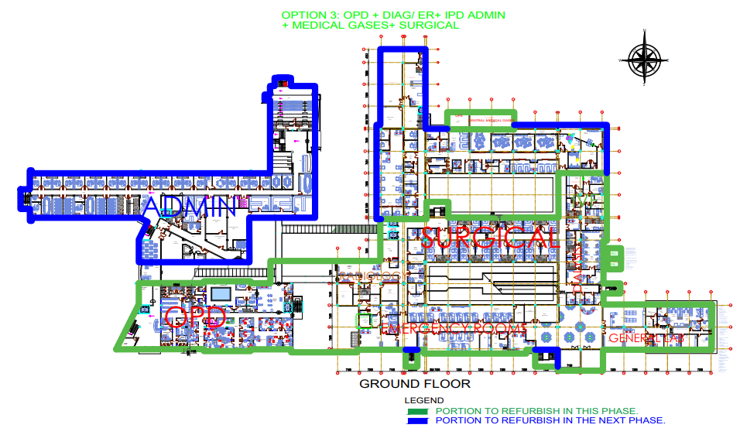
Selected option
Option 3
Included
OPD
IPD
Diagnostics
ER
Medical gases
Excluded
ADMINISTRATIVE BLOCK
Portions of IPD
MORTUARY
Diagnostic, Dialysis, IVF, & ER
Legend
Excluded regions
Included regions
TANIT MEDICAL ENGINEERING
TANIT MEDICAL ENGINEERING January 2023

Slide 5
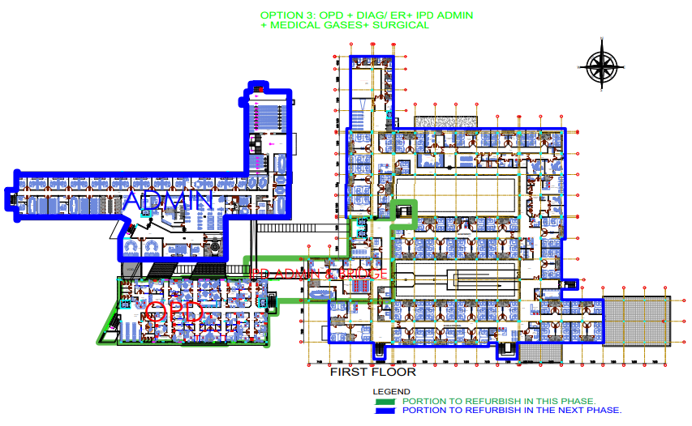
Selected option
Option 3
Included
OPD
IPD
Diagnostics
ER
Medical gases
Excluded
ADMINISTRATIVE BLOCK
Portions of IPD
MORTUARY
TANIT MEDICAL ENGINEERING
TANIT MEDICAL ENGINEERING January 2023

Slide 6
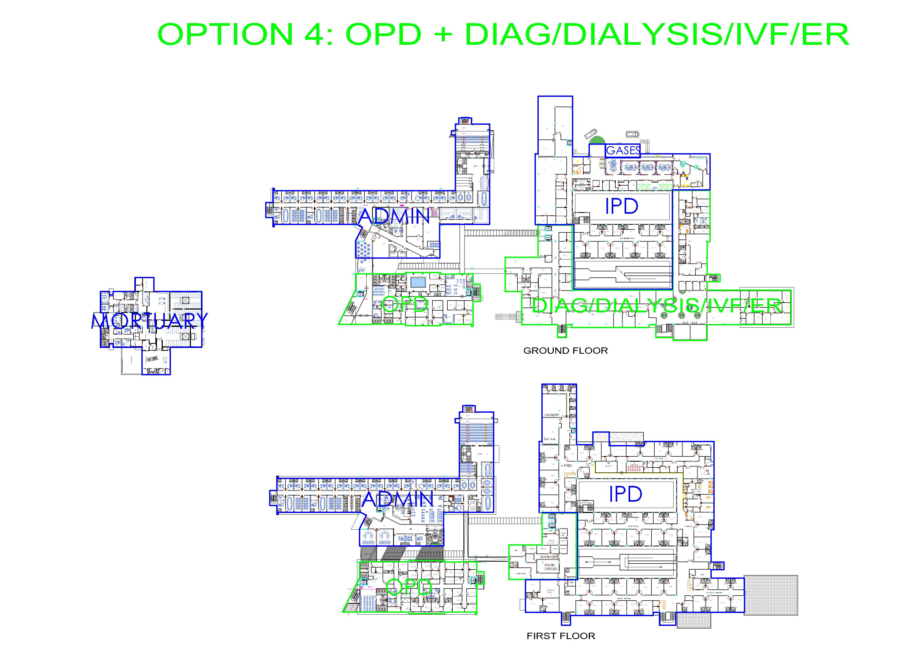
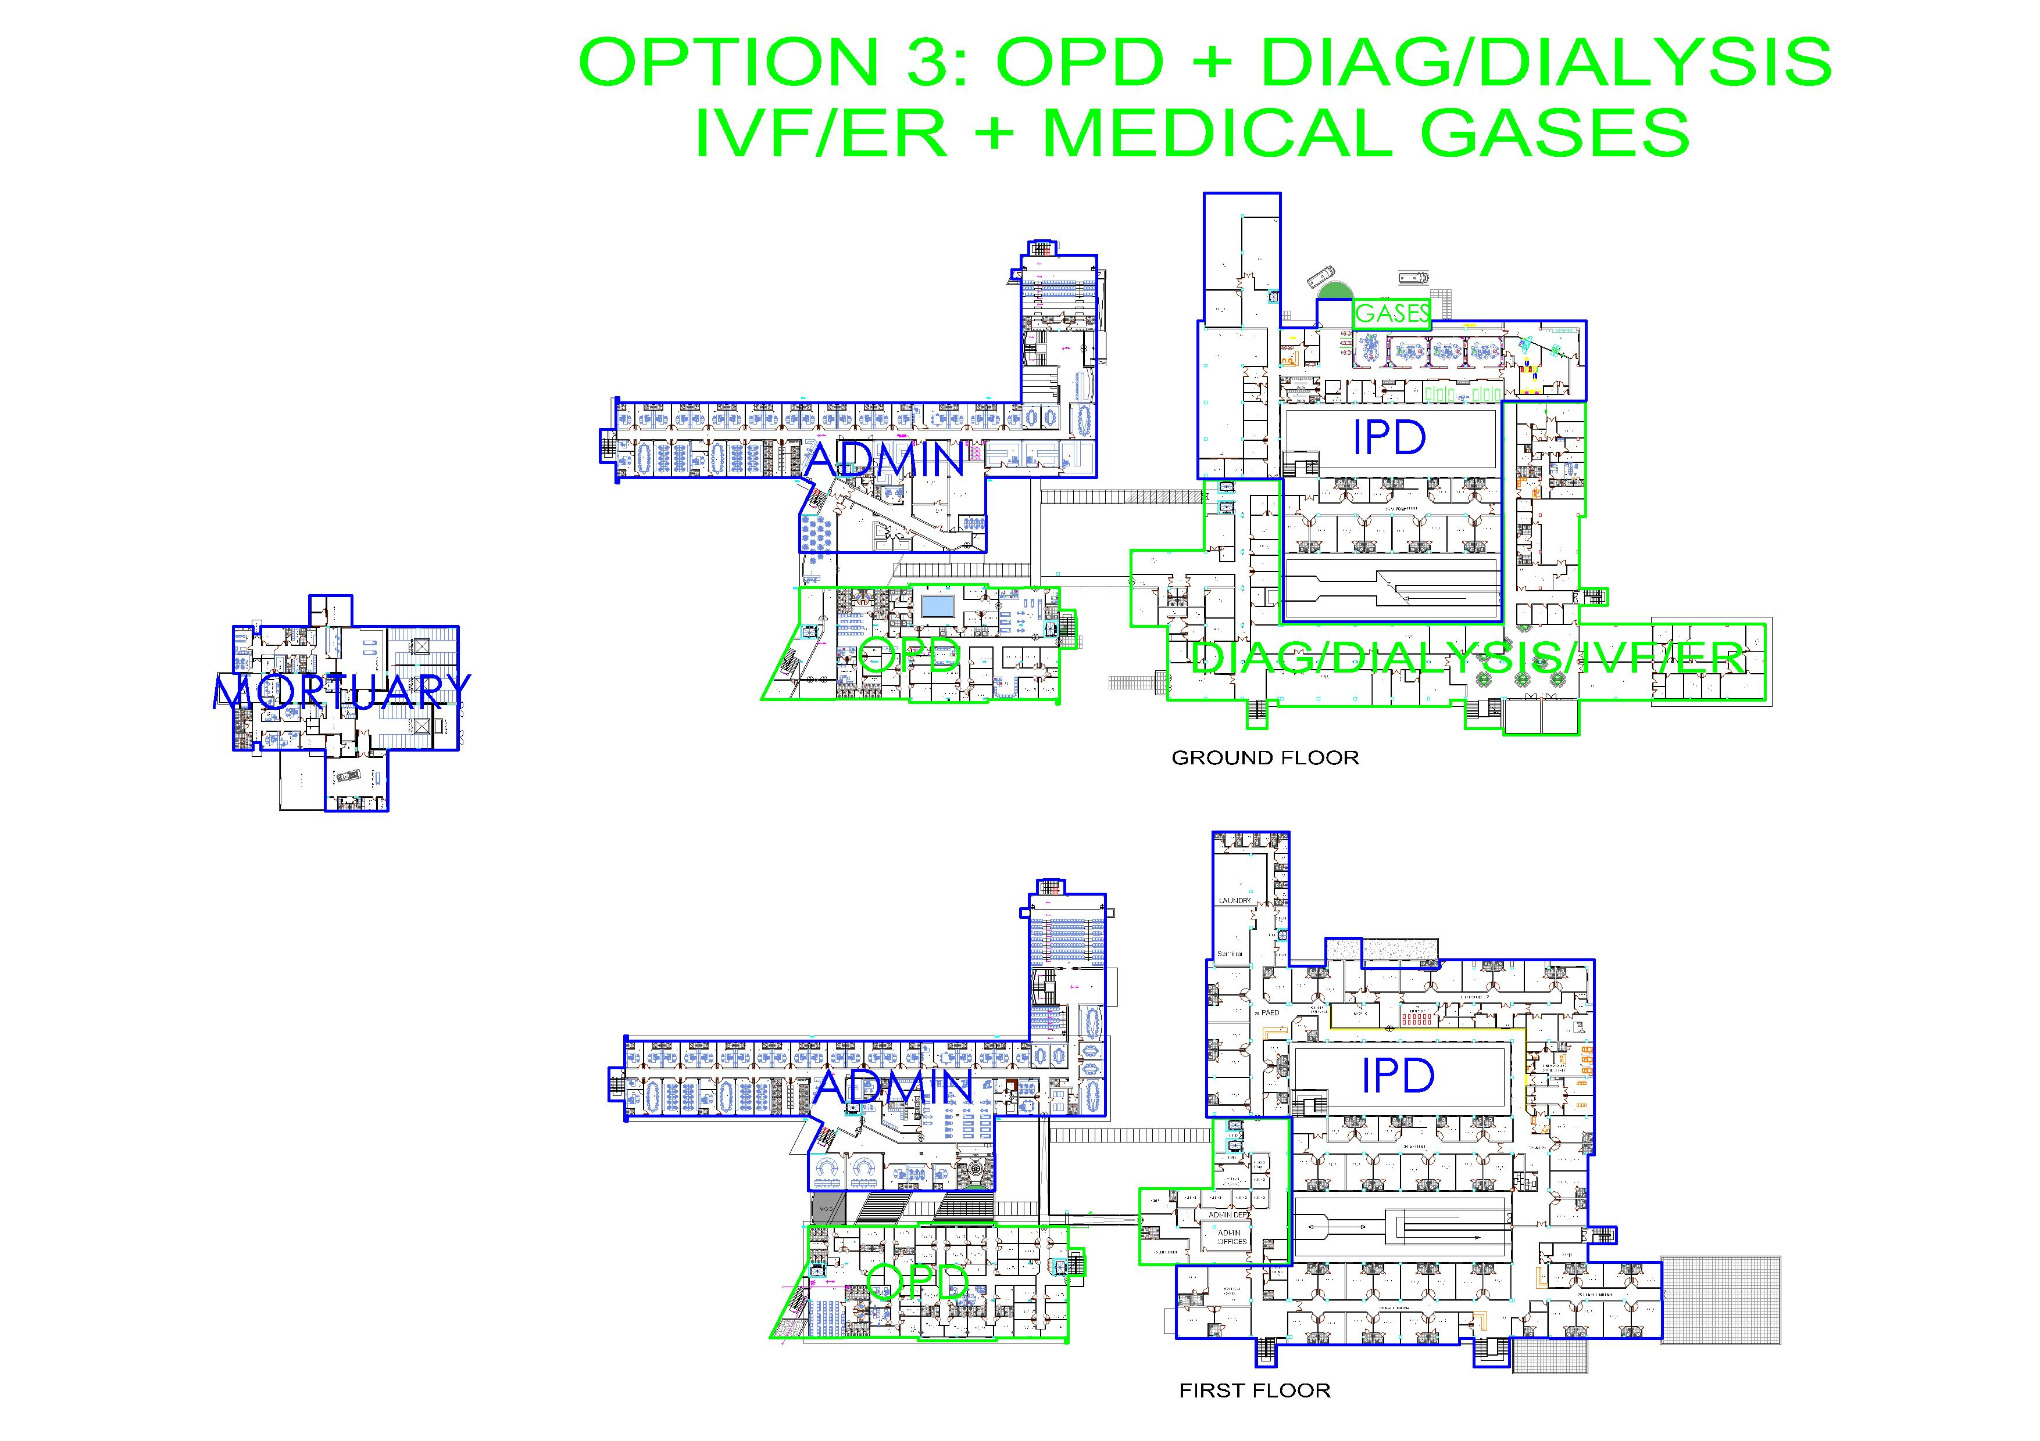
Phasing options
Option 4
Included
OPD
IPD
Diagnostics
Dialysis
IVF
ER
Excluded
ADMINISTRATIVE BLOCK
Portions of IPD
Medical gases
MORTUARY
OPD
Diagnostic & ER
Legend
Excluded regions
Included regions
OPD
TANIT MEDICAL ENGINEERING
TANIT MEDICAL ENGINEERING January 2023

Slide 7
General cost breakdown
 |  | STELLA OBASANJO HOSPITAL PHASE PLANNING
 |  |  | FULL PROJECT 9-12 MONTHS | Option 1 (9-12 months) | Option 2 (6-9 Months) | Option 3 (6-9 Months) | Option 4 (6-7 Months)
 |  | Description | FULL PROJECT WITH ADMIN | Full Project LESS ADMIN | OPD + DIAG/DIALYSIS/IVF/ER + MORTUARY + MEDICAL GASES | OPD + DIAG/DIALYSIS/IVF/ER + MEDICAL GASES | OPD + DIAG/DIALYSIS/IVF/ER
S/No. | CONTRACTOR | ITEMS
1 | A & K Construction Limited | OPD - Out Patient Department | 1,176,578,029.99 | 1,176,578,029.99 | 1,176,578,029.99 | 1,176,578,029.99 | 1,176,578,029.99
2 | A & K Construction Limited | IPD - In Patient Department | 3,129,724,081.10 | 3,129,724,081.10 | 1,877,834,448.66 | 1,564,862,040.55 | 1,564,862,040.55
3 | A & K Construction Limited | Administrative Block | 2,400,786,761.68 | - | - | - | -
4 | TO BE ADVISED - TBA | Mortuary (Estimate) | 250,000,000.00 | 250,000,000.00 | 250,000,000.00 | 0.00 | 0.00
 |  | SUB TOTAL - CONSTRUCTION | 6,957,088,872.77 | 4,556,302,111.09 | 3,304,412,478.65 | 2,741,440,070.54 | 2,741,440,070.54
 |  | Expected Construction Variation @10% | 695,708,887.28 | 455,630,211.11 | 330,441,247.87 | 274,144,007.05 | 274,144,007.05
 |  | Construction Total | 7,652,797,760.05 | 5,011,932,322.20 | 3,634,853,726.52 | 3,015,584,077.59 | 3,015,584,077.59
1 | SUDABELT MEDICAL CO. LTD | Lot 1 - Medical Equipment | 4,135,198,000.00 | 4,135,198,000.00 | 1,566,785,650.00 | 1,385,962,650.00 | 1,566,785,650.00
2 | SUDABELT MEDICAL CO. LTD | Lot 2 - Radiology | 2,104,552,000.00 | 2,104,552,000.00 | 2,104,552,000.00 | 2,104,552,000.00 | 2,104,552,000.00
3 | SUPREME MEDITECH LTD. | Lot 3 - Medical Gases | 648,989,222.31 | 648,989,222.31 | 648,989,222.31 | 648,989,222.31 | -
4 | SUPREME MEDITECH LTD. | Lot 4 - Mortuary | 129,241,980.00 | 129,241,980.00 | 129,241,980.00 | - | -
5 | SUDABELT MEDICAL CO. LTD | Lot 5 - Laboratory | 1,090,041,596.00 | 1,090,041,596.00 | 1,090,041,596.00 | 803,323,944.00 | 1,090,041,596.00
6 | REEDPRICEMAN | KITCHEN LAUNDRY TOOLS + FURNITURE | 339,472,422.50 | 339,472,422.50 | - | - | -
7 | BLUEHUB LTD | IT EQUIPMENT AND AUDIOVISUALS | 357,722,837.25 | 134,105,239.50 | 83,156,302.50 | 83,156,302.50 | 83,156,302.50
8 | SABTRAK LTD | APPLIANCES | 42,407,202.00 | 35,573,814.00 | 10,870,185.00 | 10,870,185.00 | 10,870,185.00
9 | REEDPRICEMAN | OFFICE FURNITURE | 1,492,211,413.00 | 809,369,069.50 | 429,106,298.75 | 429,106,298.75 | 429,106,298.75
 |  | EQUIPMENT AND FURNISHING SUB TOTAL | 10,339,836,673.06 | 9,426,543,343.81 | 6,062,743,234.56 | 5,465,960,602.56 | 5,284,512,032.25
 |  | Expected Equipment & Furnishing Variation@5% | 516,991,833.65 | 471,327,167.19 | 303,137,161.73 | 273,298,030.13 | 264,225,601.61
 |  | TOTAL EQUIPMENT AND FURNISHING COST | 10,856,828,506.71 | 9,897,870,511.00 | 6,365,880,396.29 | 5,739,258,632.69 | 5,548,737,633.86
 |  | SCENARIO TOTAL SUM | 18,509,626,266.76 | 14,909,802,833.20 | 10,000,734,122.80 | 8,754,842,710.28 | 8,564,321,711.46
 |  |  | DIFFERENCE | 3,599,823,433.56 | 8,508,892,143.96 | 9,754,783,556.48 | 9,945,304,555.30
 |  | EQUIPMENT PAYMENT PLAN
 |  | Initial Payment (15 days) 80% | 8,685,462,805.37 | 7,918,296,408.80 | 5,092,704,317.03 | 4,591,406,906.15 | 4,438,990,107.09
 |  | Next Payment (60 days) 10% | 1,085,682,850.67 | 989,787,051.10 | 636,588,039.63 | 573,925,863.27 | 554,873,763.39
 |  | Final Payment (Post Deployment) 10% | 1,085,682,850.67 | 989,787,051.10 | 636,588,039.63 | 573,925,863.27 | 554,873,763.39
 |  | This is excludes all Preoperational cost
 | APPROXIMATE ESTIMATED COST OF MORTUARY
 | Total floor area of OPD IS 2,458
 | Total contract sum of OPD IS 1,176,578,029.99
 | Cost per m2 cost/are= N478,672.92
 | TOTAL FLOOR AREA OF MORTUARY SHOULD BE NO MORE THAN 550 M2 |  | TO BE REDESIGNED
 | Utilizing average cost Per Sq. metre of N445,545.00
 | This gives - N454,545.00 x 550 = N 250,000,000.00
 | Cost of constructing mortuary is N 250,000,000 - Estimated
FULL PROJECT
(WITH ADMINISTRATIVE BLOCK)
₦19,026,618,100.41
Phase
TANIT MEDICAL ENGINEERING
TANIT MEDICAL ENGINEERING January 2023

Slide 8
Preferred option
We strongly advice option 3 as it falls in line with setting the stage for a quick completion of the project later on,
As well as being able to function and generate funds immediately.
FULL PROJECT
(WITH ADMINISTRATIVE BLOCK)
₦18,509,626,266.76
Phase
OPTIONS | SCENARIO TOTAL SUM (₦) | DIFFERENCE (₦) | SCENARIO COVERAGE AREAS
OPTION 3 | 8,754,842,710.28 | 9,754,783,556.48 | OPD,IPD(DIAGNOSTIC, ER AND MEDICAL GASES), BUT EXCLUDING ADMINISTRATIVE BLOCK , ALL OTHER PORTIONS OF IPD, AND MORTUARY
TANIT MEDICAL ENGINEERING
TANIT MEDICAL ENGINEERING January 2023

Slide 9

End of Presentation
A big thank you from all of us
at
Tanit Medical Engineering
₦19,026,618,100.41
TANIT MEDICAL ENGINEERING
TANIT MEDICAL ENGINEERING January 2023

